Slide 1

EE 272 Digital Systems Fall 2019
Instructor: Dr. Aashir Waleed
Lecture 3 – 1
Chapter 3
Gate Level Minimization (K-maps)

Slide 2
Lecture Overview
Lecture 3 – 2
 Two-level logic minimization
 K-map method
 Other methods of logic minimization
 Reading assignment: Chapter 3.1 to 3.6

Slide 3
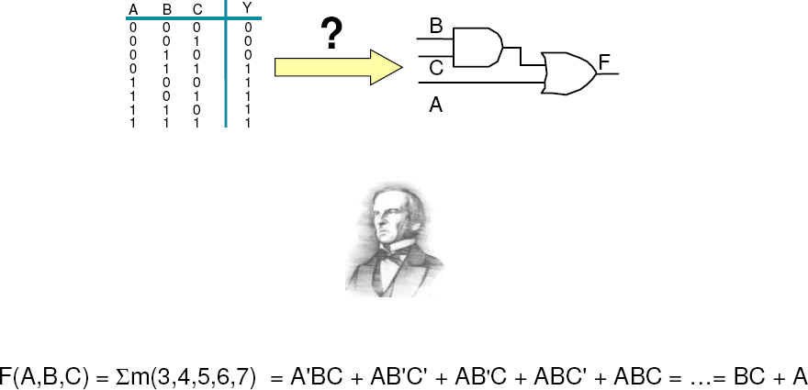
Boolean Algebra & Logic Circuits
Lecture 3 – 3

Slide 4
Example – Full Adder Design
Lecture 3 – 4
 Specifications – calculating 1-bit of binary addition
 Add two binary digits and Carry in to produce Sum and Carry out E.g.
Boolean Expression (Canonical Form, Sum of Minterms)
Sum = A ' B 'C + A ' BC' + AB 'C' + ABC
in in in in
C = A ' BC + AB 'C + ABC' + ABC
out in in in in
A | B | Cin | Sum | Cout
0 | 0 | 0 | 0 | 0
0 | 0 | 1 | 1 | 0
0 | 1 | 0 | 1 | 0
0 | 1 | 1 | 0 | 1
1 | 0 | 0 | 1 | 0
1 | 0 | 1 | 0 | 1
1 | 1 | 0 | 0 | 1
1 | 1 | 1 | 1 | 1

Slide 5
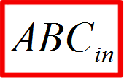
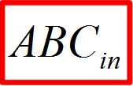
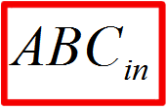
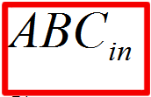
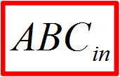
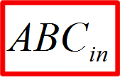
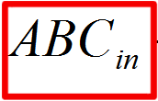
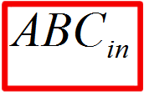
Example – Full Adder Design
Lecture 3 – 5
 Boolean expression simplification
C = A' BC + AB'C + ABC' + ABC
in
+
out in in in
Identity Associative
= A' BC + AB'C
= A' BC +
ABC' +
ABC_{in}
ABC_{in}
in
in in
ABC_{in}
AB'C
ABC' +
ABC_{in}
in
in
in
distributive
Identity Associative
distributive distributive complement
=(A'+ A)BC
AB'C
ABC' + ABC
+
in
in
in
in
= BC + AB'C
= BC + AB'C +
= BC
= BC
ABC'
+
ABC_{in}
ABC_{in}
in
in
in
ABC_{in}
ABC' +
ABC_{in}
in
in
in
A(B'+B)C
ABC' + ABC
in
in
in
in
AC + AB(C' + C )
in in
AC_{in} + AB
in
in
= BC_{in}
Sum = A' B'C + A' BC' + AB'C' + ABC
in in in
in
=

Slide 6
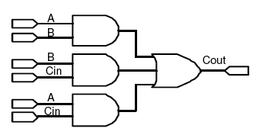
Example – Full Adder Design
Lecture 3 – 6
 Implementation
C_{out} = A' BC_{in} + AB'C
ABC' + ABC
in
in
in
= BC_{in} + AC_{in} + AB
Sum = A' B'C
=
A' BC' + AB'C' + ABC
in in
in
in

Slide 7
Karnaugh Map Method
Lecture 3 – 7
 Truth table and Karnaugh Map (K-Map)
 Truth table: input/output relation in one-dimensional table
 K map: input/output relation in two-dimensional graph
 K-map helps visualize adjacencies in up to 6 variables
 but it is hard to draw cubes of more than 4 variables
 Beyond that, computer-based methods are needed
 Adjacency is arranged in 2-bit Gray code sequence
 00, 01, 11, 10
 only one-bit change from one code word to the next code word
A
_{B} 0 1
0 0 2
1 3
AB
A
C
00 01 11 10
0 2 6 4
2-variable K-map
0
3-variable K-map
1
1
1 3 7 5
B
In the K-map, adjacency wraps from left to right and from top to bottom

Slide 8
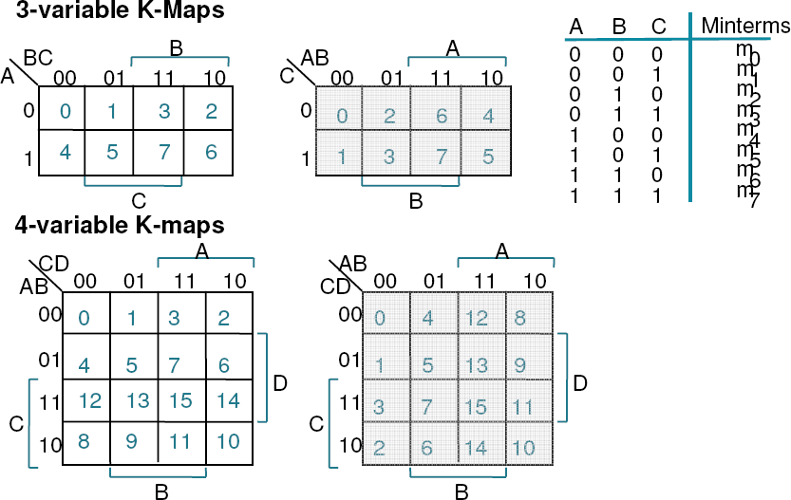
Mapping minterms to table locations...
Lecture 3 – 8
C
B
A
D
 Always make sure the order of minterms corresponds to the variables in the right order!

Slide 9
F = A.B + A.B
= A(B + B)
Lecture 3 – 9
Logic Minimization using K-Map
Logic minimization
(2 AND gates, 1 OR gate to a wire)
A | B | F
0 | 0 | 0
0 | 1 | 0
1 | 0 | 1
1 | 1 | 1
A
A
B
0
1
F = A
B
0
1
Circle as many ones as we can with one circle.
Note that all the entries inside the circle has to be 1
A
A
B
0
1
B
0
1
You can only circle adjacent 1s to form a bigger circle, if the 1’s are not adjacent, they cannot be circled

Slide 10
Logic Minimization using K-Map
Lecture 3 – 10
A | B | F
0 | 0 | 0
0 | 1 | 1
1 | 0 | 1
1 | 1 | 0
Do not group like this as the two cells are not Booelan adjacent (more than one literal changes between them)
A
A
B
0
1
B
1
0
A
A
B
0
1
Groups have to be in RECTANGLE shape!
1
0
B
You can only group individually in this case. No minimization!
A
A
B
0
1
B
1
0
F=AB’ +A’B

Slide 11
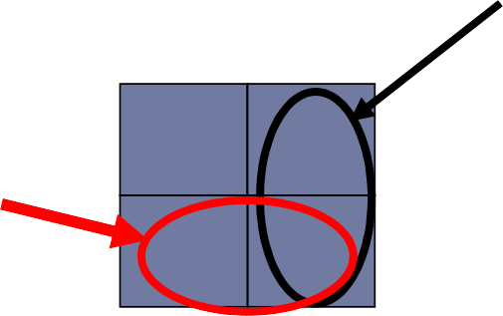
Logic Minimization using K-Map
Lecture 3 – 11
OR Function
A
F = A’B + AB’ + AB
= A’B + AB’ + AB + AB
= B (A’ + A) + A (B’ +
A | B | F
0 | 0 | 0
0 | 1 | 1
1 | 0 | 1
1 | 1 | 1
A
B
0
1
B)
B
1
1
= A + B
A
A
A
1
B
B
0
AND Function
F = A + B
B
1
1
A | B | F
0 | 0 | 0
0 | 1 | 0
1 | 0 | 0
1 | 1 | 1
A
A
B
0
0
F = AB
B
0
1
AB
Nothing eliminated

Slide 12
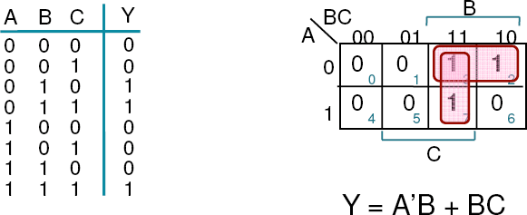
Lecture 3 – 12
Karnaugh Map Method
 Represent the function as a Karnaugh map
 Mark adjacent squares containing 1’s
 in rectangular groups of 1, 2, 4, 8 etc…
 make these groups as big as you can!
 Write down the minimised Boolean sum-of-products expression!
 For product terms, note values of variables that do not change for each group
 Groups of 2 reduce 1 variable, groups of 4 reduce 2 variable, etc.
Example: F(A,B,C) =
∑(2,3, 7)

Slide 13


Why does K-map work
Lecture 3 – 13
 1’s in the K-map correspond to minterms
 Adjacent squares are minterms that differ in one variable only
 Since A’BC’ + A’BC = A’B(C+C’) = A’B these minterms can be reduced
 K-map helps you to spot all such possibilities for reduction
Y = A’BC’ + A’BC + ABC =
Repeated terms represents
= A’BC’ + + + ABC =
A’BC
A’BC
= A’B (C+C’) + (A+A’)BC =
= A’B + BC
overlapping squares in the above K-map

Slide 14
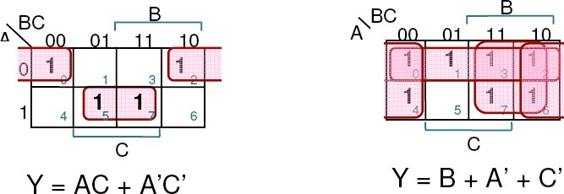
Some more examples (3-variables)
Lecture 3 – 14
A
A B
_{Cin} 00 01 11 10
0 0 0 1 0
A
AB
C 00 01 11 10
0 0 0 1 1
1 0 1 1 1
B
Cout = A B + B Cin + A Cin carry output of the full adder
1 0 0 1 1
B
F(A,B,C) = A

Slide 15
4-Variable K-Map
Lecture 3 – 15
A 00 01 11 10
AB CD
00
0 | 4 | 12 | 8
1 | 5 | 13 | 9
3 | 7 | 15 | 11
2 | 6 | 14 | 10
01
D
11
C
10
B
 Find the smallest number of the largest possible sub-cubes that cover the ON-set (minterms=1)
 Sub-cubes have 1, 2, 4, 8 and 16 (2^{n}) elements for 4 (n)-variable K-MAP.
 1-element sub-cube for 4-variable expression,
 2-element sub-cube for 3-variable expression,
 4-element sub-cube for 2-variable expression,
 8-element sub-cube for 1-variable expression,
 16-element sub-cube for 0-variable expression (i.e. F = 1)

Slide 16
4-Variable K-Map
Lecture 3 – 16
AB CD
A
00 01 11 10
F(A,B,C,D) = Σm(0,2,3,5,6,7,8,10,11,14,15)
F = C + A' B D + B' D'
00 1
0
0
1
01
0
1
0
0
D
11 1
1
1
1
C
10
1
1
1
1
B

Slide 17
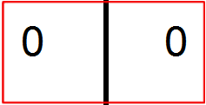
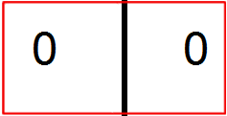
Sum of Products and Product of Sums
Lecture 3 – 17
AB C
A
Minterms
F(A,B,C) = Σm(0,4,5,7) F = B' C' + A C
00
01
11
10
0 1
0 0
1
1
0 0
1
1
You could also minimize Maxterm directly
B
AB C
A
00
01
11
10
Maxterms
F'(A,B,C) = Σm(1,2,3,6) F' = B C' + A' C
F = (B’ + C) (A + C’)
0
0 |  |  |  |  |  |  | 0
 |  |  | 1 |  | 1
 |  |  |  |  | 0 |  | 0
 | 1 | 1
1
B

Slide 18

Don’t Cares and K-Map
Lecture 3 – 18
AB CD
00
A
00 01 11 10
F(A,B,C,D) = Σm(1,3,5,7,9) + Σd(6,12,13)
0 |  | 0 |  | X | 0
 | 1 | 1 |  | X | 1
 | 1 | 1 |  | 0 | 0
0 |  | X |  | 0 | 0
F = A'D + B' C' D
w/o don't cares
w/ don't cares
01
F = C' D + A' D
D
11
C
Treat this X as a "1” and form a sub-cube of 4 elements, instead of 2 elements
10
B
AB CD
00
A
00 01 11 10
In Maxterm
1 | 1 | X | 1
0 | 0 | X | 0
0 | 0 | 1 | 1
1 | X | 1 | 1
F’ = D’ + AC
01
D
F = D (A' + C')
11
C
10
Same function, but fewer literals
B
Don't Cares can be treated as 1's or 0's if it is advantageous to do so

Slide 19
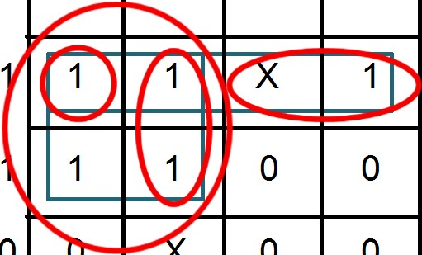
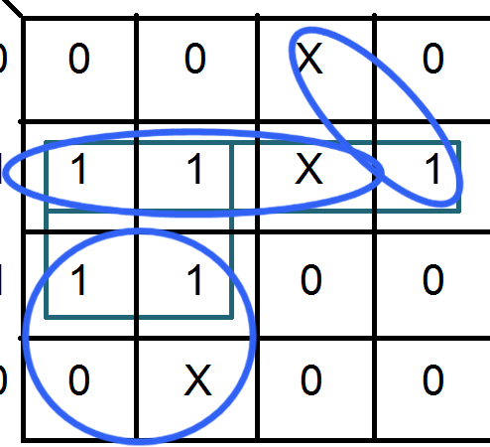


K-map simplification mechanism
Lecture 3 – 19
 Some definitions
 Implicant:
 Single element of the ON-set or any group of 2^{n} elements that can be combined together in a K-map
 Top/bottom rows, left/right columns, and corners are adjacencies.
Implicants: Not implicants:
AB
A
CD
00
00 01 11 10
AB CD
A
0
0
X
0
00 01 11 10
00 0 0 X 0
01 1 1 X 1
11 1 1 0 0
10 0 X 0 0
0
1 X 1
1 1 0 0
0 0 X 0 0
1
1
1
D
1
D
C
1
C
B
B

Slide 20
K-map simplification mechanism
Lecture 3 – 20
 Some definitions
 Implicant:
 Single element of the ON-set or any group of 2^{n} elements that can be combined together in a K-map
 Top/bottom rows, left/right columns, and corners are adjacencies.
 Prime Implicant:
 Implicant that cannot be combined with another implicant to eliminate a term
 Essential Prime Implicant:
 if an element of the ON-set is covered by a single prime implicant, it is an essential prime
 Procedure
 Grow implicants into prime implicants
 Cover the ON-set with as few prime implicants as possible
 Essential primes participate in ALL possible covers

Slide 21
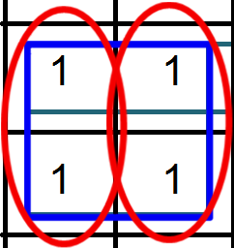

Prime Implicant: Implicant that cannot be combined with
Lecture 3 – 21
another implicant to eliminate a term
AB CD
00
A
00 01 11 10
F(A,B,C,D) = Σm(1,3,5,7,9) + Σd(6,12,13)
0
0
X
0
F = A'D + B' C' D
w/o don't cares
w/ don't cares
01
1 1
1 1
X
1
F = C' D + A' D
D
11
0
0
C
0
X
0
0
Treat this X as a "1” and form a sub-cube of 4 elements, instead of 2 elements
10
B
A’B’D
A’BD
A'D is a prime implicant because it cannot be combined with another implicant to eliminate a term
A’B’D and A’BD are implicants but they are NOT “prime” implicants because they both can be combined to eliminate B!
A’B’D+A’BD = A’D(B+B’) = A’D

Slide 22
K-map simplification mechanism
Lecture 3 – 22
 Some definitions
 Implicant:
 Single element of the ON-set or any group of 2^{n} elements that can be combined together in a K-map
 Top/bottom rows, left/right columns, and corners are adjacencies.
 Prime Implicant:
 Implicant that cannot be combined with another implicant to eliminate a term
 Essential Prime Implicant:
 if an element of the ON-set is covered by a single prime implicant, it is an essential prime
 Procedure
 Grow implicants into prime implicants
 Cover the ON-set with as few prime implicants as possible
 Essential primes participate in ALL possible covers

Slide 23




Essential Prime Implicant if an element of the ON-set is covered by a single prime implicant, it is an essential prime
ELEC2200 Fall 2014 – L.Yobas Lecture 3 – 23
A B
A
Minterms
F(A,B,C) = Σm(0,2,5,6,7) F = A’C’ + BC’ + AC
00 01 11 10
0 1 1 1 0
C
1 0 0
1
1
B
A
A B
Minterms
F(A,B,C) = Σm(0,2,5,6,7) F = A’C’ + AB + AC
C
 | 00 | 01 |  | 11 | 10
0 | 1 | 1 |  | 1 | 0
1 | 0 | 0 |  | 1 | 1
 |  |  | B
Both A’C’ and AC are “essential” prime implicants because of the yellow cells. There is no other prime implicant to cover yellow cells!

Slide 24
K-map simplification mechanism
Lecture 3 – 24
 Some definitions
 Implicant:
 Single element of the ON-set or any group of 2^{n} elements that can be combined together in a K-map
 Top/bottom rows, left/right columns, and corners are adjacencies.
 Prime Implicant:
 Implicant that cannot be combined with another implicant to eliminate a term
 Essential Prime Implicant:
 if an element of the ON-set is covered by a single prime implicant, it is an essential prime
 Minimization Procedure
 Grow implicants into prime implicants
 Cover the ON-set with as few prime implicants as possible
 Essential primes participate in ALL possible covers

Slide 25
Examples of Implicants
Lecture 3 – 25
AB CD
00
A
00 01 11 10
6 Prime Implicants:
A’B’D, BC', AC, A’C’D, AB, B’CD
0 | 1 | 1 | 0
1 | 1 | 1 | 0
1 | 0 | 1 | 1
0 | 0 | 1 | 1
01
11
^{C} 10
D
essential
Minimum cover = B C' + A C + A' B' D
B
A
AB
_{CD} 00 01 11 10
00 0 0 1 0
01 1 1
5 Prime Implicants:
BD, ABC', ACD, A’BC, A’C’D
1
0
D
11 0
C
1
1
1
essential
4 essential implicants form minimum cover
10 0
1
0 0
B

Slide 26
Implicants & Prime Implicants
Lecture 3 – 26
A Sum-of-Product (SOP) expression containing a term which is not a Prime Implicant CANNOT be a minimum
Minimum cover:
Not a minimum:
F = ABC’D’ + BD + ACD + A’BC + A’C’D
F = ABC’ + ACD + A’BC + A’C’D
AB
AB
_{CD} 00 01 11 10
00 0 0 1 0
01 1 1 1 0
11 0 1 1 1
10 0 1 0 0
CD
00 0 0 1 0
01 1 1 1 0
11 0 1 1 1
10 0 1 0 0
00 01 11 10
ABC’D’ is NOT a prime implicant because it can be combined with ABC’D to get ABC’ which is a prime implicant and it is essential!
BD is a prime implicant but NOT essential because it entirely overlaps by all the other terms
A Sum-of-Product (SOP) expression that is considered minimum contains only the Prime Implicants (not necessarily all but some) (For instance BD above is not in minimum)
To find the minimum SOP from K-MAP, find a minimum number of prime implicants which cover all the “1s”
Roth & Kinney

Slide 27
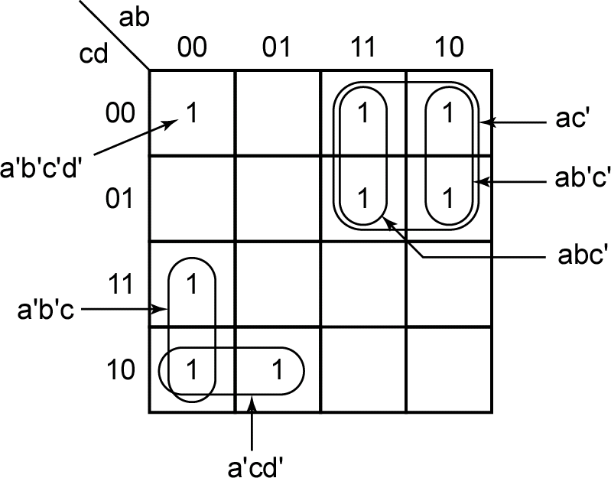
Implicants & Prime Implicants
Lecture 3 – 27
“Prime” implicants can NOT be combined with other terms to eliminate a variable whereas implicants can
Prime Implicant
Implicant
Implicant
Implicant
Prime Implicant
Prime Implicant
Roth & Kinney

Slide 28
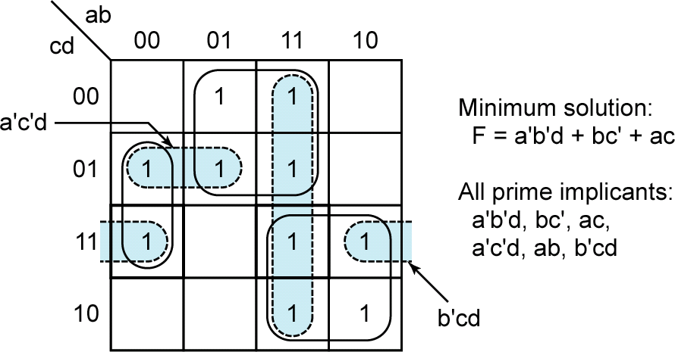
Identifying Prime Implicants
ELEC2200 Fall 2014 – L.Yobas Lecture 3 – 28
3 out of 6 Prime Implicants cover all the “1s” → minimum SOP Shaded prime implicants are not part of the minimum SOP a’c’d is still a prime implicant because it cannot be combined with other 1’s to eliminate other variable
Roth & Kinney

Slide 29
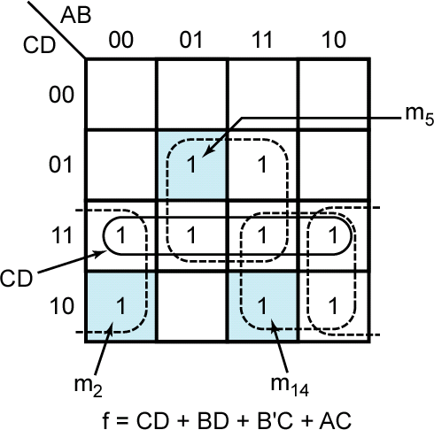
Identifying required terms
Lecture 3 – 29
If a minterm is covered by only one prime implicant, that prime implicant is said to be “essential” and must be included in minimum SOP
Any term redundant?
Roth & Kinney

Slide 30
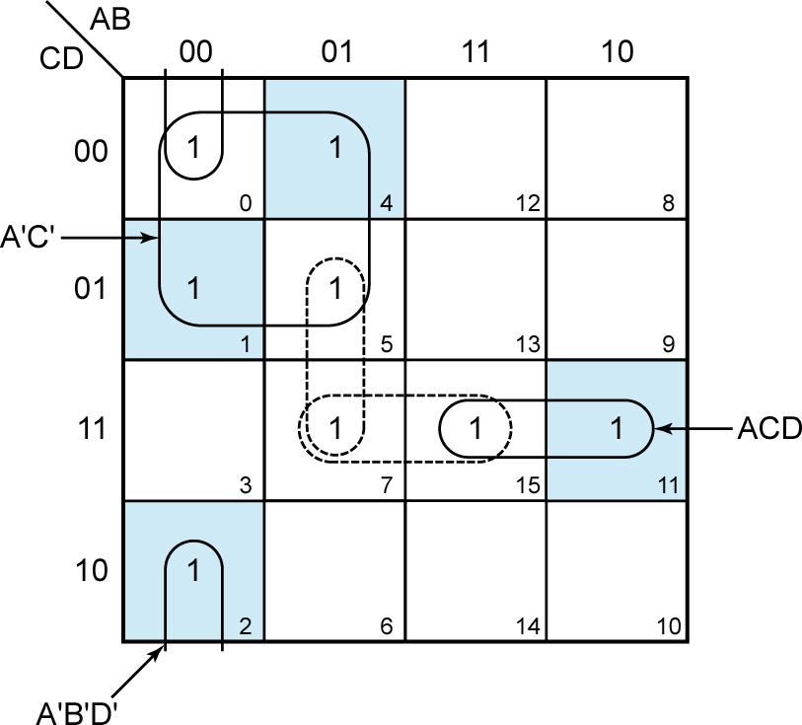
Identifying essential prime implicants
Lecture 3 – 30
Note: 1’s shaded in blue are covered by only one prime implicant. All other 1’s are covered by at least two prime implicants.
⎧A' BD⎫
⎪ ⎪
A'C'+A' B' D'+ACD +⎨ or
⎬
⎪ BCD ⎪
⎩
⎭
Roth & Kinney

Slide 31
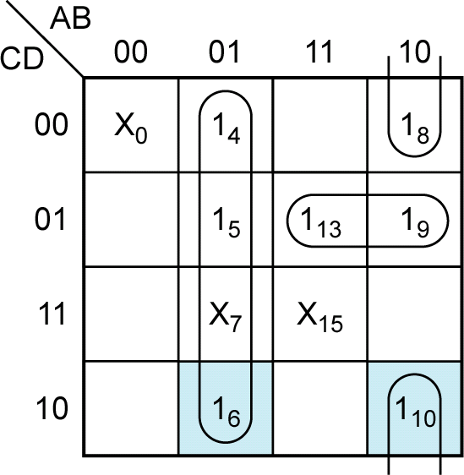
Determining minimal cover
Lecture 3 – 31
Shaded 1’s are covered by only one prime implicant.
Essential prime implicants:
A′B, AB′D′
Then AC′D covers the remaining 1’s.
Roth & Kinney

Slide 32







Determining minimum SOPs
Lecture 3 – 32
Find all adjacent 1’s and X’s
Choose a “1” which has not been covered
DONE
Are the chosen 1 and its adjacent 1’s and X’s covered by a single term?
Find a minimum set of prime implicants which cover the remaining 1’s on the map
All essential prime
implicants are known by now
YES
NO
YES
All uncovered 1’s checked?
NO
That terms is an essential prime implicant. Loop it.
Roth & Kinney

Slide 33



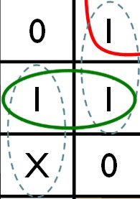


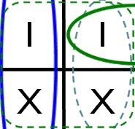





Lecture 3 – 33
F = A’B + AB’D’ + AC’D
A 00 01 11 10
00 X
01 0
11 0
^{C} 10 0
A’B
Choose a “1” which has not been covered
Find all adjacent 1’s and X’s
AB
CD
1
1
X 1
0 1
1 1
X 0
DONE
AC’D
D
Are the chosen 1 and its adjacent 1’s and X’s covered by a single term?
Find a minimum set of prime implicants which cover the remaining 1’s on the map
0 1
AB’D’
B
Initial K-map
NO
ABD is NOT a prime implicant BD is a prime implicant
YES
All essential prime implicants are known by now
YES
All uncovered 1’s checked?
NO
That terms is an essential prime implicant. Loop it.
Roth & Kinney

Slide 34
K-Map Simplification Example
Lecture 3 – 34
Example: F(A,B,C,D) = Σm(4,5,6,8,9,10,13) + d(0,7,15)
AB CD
00
A A
A
AB CD
AB
_{CD} 00 01 11 10
00 X 1 0 1
00 01 11 10
00 01 11 10
00 X 1 0 1
01 0
11 0
^{C} 10
X | 1 | 0 | 1
0 | 1 | 1 | 1
0 | X | X | 0
0 | 1 | 0 | 1
01
11
^{C} 10
1
1
1
1
1
D
D
01 0
1
X
X
11 0
^{C} 10 0 1 0 1
B
Primes around A' B C' D
D
0
X
X
0
0 1 0 1
B
Primes around A' B C' D'
B
Initial K-map
A’C’D’ A’B
BD
2
2+1=3

Slide 35
K-Map Simplification Example: Continued
Lecture 3 – 35
AB
_{CD} 00 01 11 10
00 X 1 0 1
A A
A
AB CD
00
AB
_{CD} 00 01 11 10
00 X 1 0 1
00 01 11 10
X | 1 | 0 | 1
0 | 1 | 1 | 1
0 | X | X | 0
0 | 1 | 0 | 1
01 0
11 0
^{C} 10 0 1 0 1
B
Primes around A B C' D
01
11
^{C} 10
01 0 1
11 0 X
^{C} 10 0 1 0
1
1
1
1
1
D
D
D
X
X
0
X
0
1
B
B
Primes around A B' C' D'
Essential Primes with Min Cover
AC’D
B’C’D’ AB’C’
AB’D’
A’B AB’D’
3+1=4
4+3=7
F(A,B,C,D) = A’B + A B’ D' + A C’ D

Slide 36
Exercises:
Lecture 3 – 36
Plot the K-MAP of the following functions:
f (A,B,C,D) = ABC'+B'C + A'
f (A,B,C,D) = BD + B' D'
Use K-MAP to show the Consensus Theorem:
XY + X ' Z + YZ = XY + X ' Z
Use K-MAP to show :
F = a'b'+bc'+ac F = a'c'+b'c + ab F = acd + a'b + d'

Slide 37
Simplify 4-variable functions
Lecture 3 – 37
cd\ab 00
01 11 10
cd\ab 00 01
00
11 10
00
 | 1 | 1
1 | 1 | 1
1
 |  |  | 1
1 |  |  | 1
 | 1
1 | 1 | 1 | 1
1 | 1 | 1 | 1
01
01
11
11
10
10
Roth & Kinney

Slide 38
Lecture 3 – 38
Simplify 4-variable functions
f = ∑m(1,3,5,7,9) +∑d(6,12,13)
Minimize the function using K-MAP
Roth & Kinney

Slide 39
Lecture 3 – 39
Example 1
Derive the minimized expression for F, and indicate all essential prime implicants.
F(A,B,C,D) =∑m(0, 5, 7,10,15) +∑d(4, 6,14)
For any essential prime implicant, identify the minterm(s) that make(s) it essential.

Slide 40
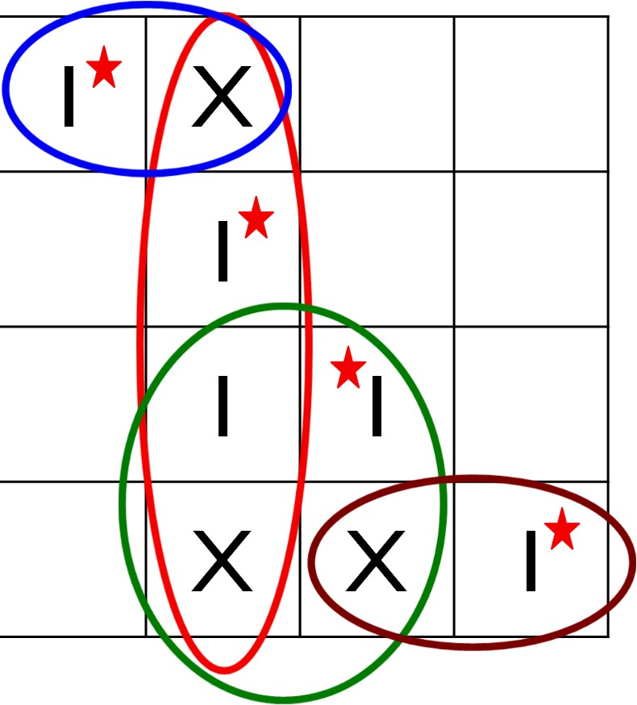
Lecture 3 – 40
Example 1
F(A,B,C,D) =∑m(0, 5, 7,10,15) +∑d(4, 6,14)
CD\AB 00
01 11 10
A’C’D’
00
1 X
1
1 1
X X 1
01
A’B
11
10
ACD’
BC
F = A’C’D’ + A’B + BC + ACD’
All 4 are essentials because of minterms 0, 5, 10, 15

Slide 41
Lecture 3 – 41
Example 2
Derive the minimized expression for G, and indicate all essential prime implicants.
G(A,B,C,D) =∏M (1, 2, 3, 8, 9,11,12,13) ⋅∏D(4, 6,14)
For any essential prime implicant, identify the maxterm(s) that make(s) it essential.

Slide 42
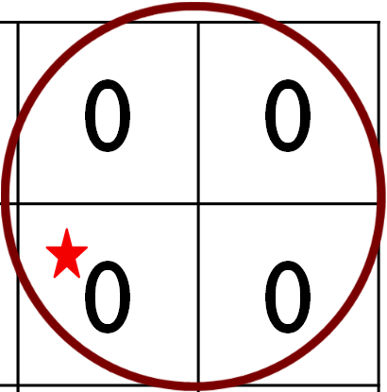




Lecture 3 – 42
Example 2
G(A,B,C,D) =∏M (1, 2, 3, 8, 9,11,12,13) ⋅∏D(4, 6,14)
CD\AB 00
01 11 10
B+D’
A’+C
00
X
0 0
0 0
01
0
11
0
0
0
10
X
X
A+B+C’
G = (B+D’)(A’+C)(A+B+C’)
2 essentials because of maxterms 1, 8, 11, 13

Slide 43
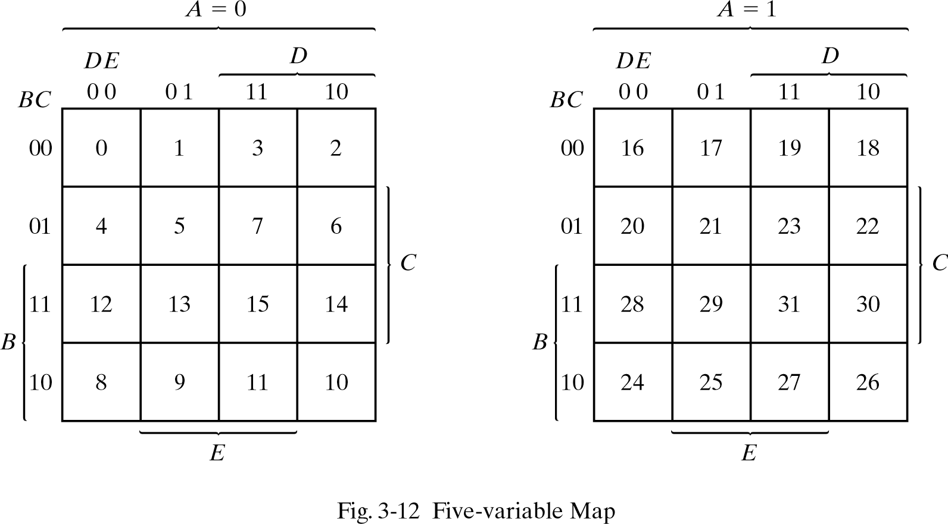
5-Variable K-Map is Doable,
Lecture 3 – 43

Slide 44
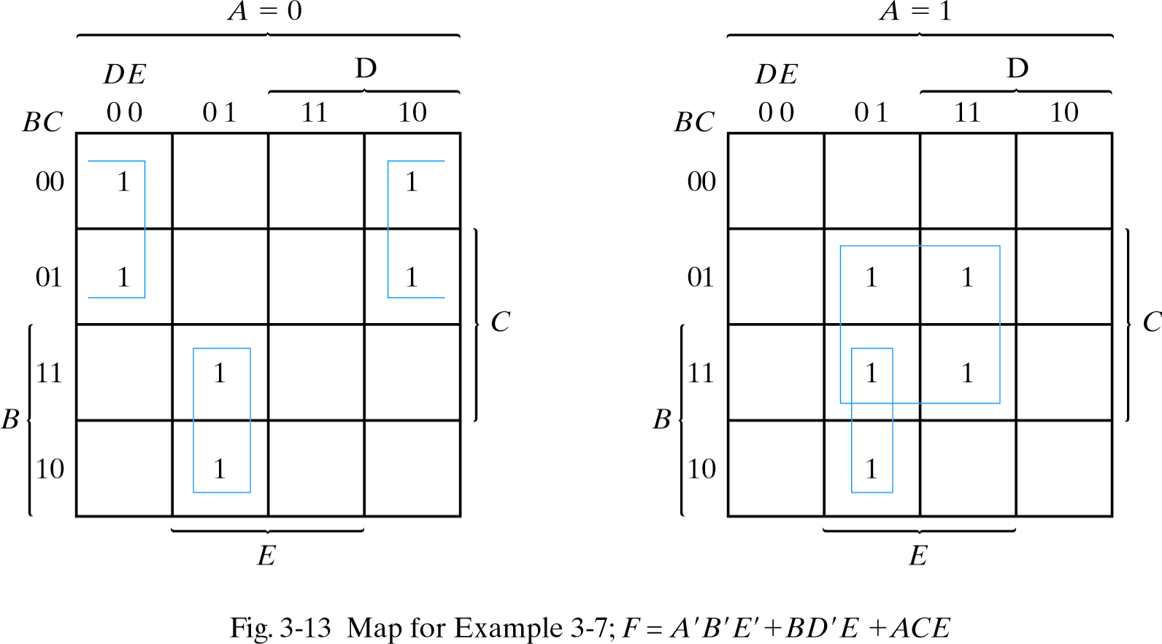
Another 5-Variable K-Map example
Lecture 3 – 44
F( A,B,C,D,E) = Σm(0,2,4,6,9,13,21,23,25,29,31)
= A’B'E’ + BD'E + ACE

Slide 45

5-Variable K-Map, The other representation
Lecture 3 – 45
BC
BC
DE 00 01 11 10
A=0 00
DE
00 | 01 | 11 | 10
0 | 4 | 12 | 8
A=0 00
1
01
01
11
1 1
1
1 5 13 9
11
1
1
3 7 15 11
1
10
2 6 14 10
BC
DE 00
10
1
BC
DE
A=1 00
01 11 10
00 01 11
0
A=1 00
16 20 28 24
1
01
17 21 29 25
01
1
1
1
11
19 23 31 27
11
1 1 1
10 ₁₈
22 30 26
10
F( A,B,C,D,E)
= Σm(2,5,7,8,10,13,15,17,19,21, 23,24,29 31)
= CE + AB'E + BC'D'E' + A'C'DE'

Slide 46
6-Variable K-Map is possible (for information)
ELEC2200 Fall 2014 – L.Yobas Lecture 3 – 46
CD
CD
00 01 11 10
^{EF} 00 01 | 11 | 10
00 ₀ ₄ | 12 | 8
EF
AB=00
AB=00
00
1
01
1 5 13 9
01
11
3 7 15 11
11
10
2 6 14 10
10
1 1
EF
CD
CD
EF 00
00 | 01 | 11 | 10
16 | 20 | 28 | 24
01 11 10
AB =01
00
AB=01
00
1
01
F( A,B,C,D,E,F)
=Σm(2,8,10,18,24,26,34,37, 42,45,50,53,58,61)
=D'EF' + ADE'F + A'CD'F'
01
17 21 29 25
11
19 23 31 27
18 22 30 26
11
10
10
1
1
EF
CD
CD
00 | 01 | 11 | 10
48 | 52 | 60 | 56
EF
00 01 11 10
AB =11
00
AB=11
00
01
49 53 61 57
01
1
1
11
51 55 63 59
50 54 62 58
11
10
10
1
1
CD
For 7-variables we need 4th dimension… definitely time to give up…
CD
EF
00 | 01 | 11 | 10
32 | 36 | 44 | 40
EF
00 01 11 10
AB =10
00
AB=10
00
01
33 37 45 41
01
1 1
11
35 39 47 43
11
10
34 38 46 42
10
1
1

Slide 47
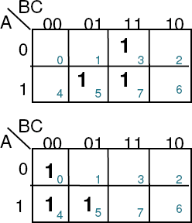
Sharing product-terms
Lecture 3 – 47
 Example – two functions are needed:
 F1 (A,B,C) = m(3,5,7)
 F2 (A,B,C)= m(0,4,5)
 Separate minimization:
 F1 = AC + BC
 F2 = AB’+B’C’
 2xNOT, 4xAND, 2xOR
 Sharing product terms:
 F1 = AB’C+BC
 F2 = AB’C+B’C’
 2xNOT, 3xAND, 2xOR
 Product-term sharing can reduce the number of required gates!

Slide 48
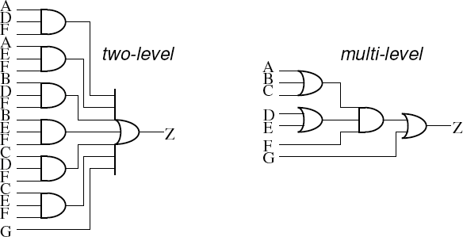
Multi-level minimization
Lecture 3 – 48
 Example:
 Minimized Sum of Products: Z = ADF + AEF + BDF + BEF + CDF + CEF + G
 Factored form: Z = (A + B + C)(D + E)F + G
 Multi-level implementations can reduce the number of gates.
 Usually, more levels of logic means longer propagation delay, hence multilevel optimized circuits can be smaller, but slower
 But, depending on the actual function & technology, there can be cases where multi- level implementation can also improve speed.

Slide 49
Example – Full Adder Design
Lecture 3 – 49
 Specifications – calculating 1-bit of binary addition
 Add two binary digits and Carry in to produce Sum and Carry
out E.g.
Boolean Expression (Canonical Form, Sum of Minterms)
A | B | Cin | Sum | Cout
0 | 0 | 0 | 0 | 0
0 | 0 | 1 | 1 | 0
0 | 1 | 0 | 1 | 0
0 | 1 | 1 | 0 | 1
1 | 0 | 0 | 1 | 0
1 | 0 | 1 | 0 | 1
1 | 1 | 0 | 0 | 1
1 | 1 | 1 | 1 | 1
Sum = A ' B 'C + A ' BC' + AB 'C' + ABC
in in in in
C = A ' BC + AB 'C + ABC' + ABC
out in in in in
Cout = A B + B Cin + A Cin
A
A B
_{Cin} 00 01 11 10
0 0 0 1 0
A
A B
_{Cin} 00 01 11 10
0 0 1 0 1
1 0 1
1
1
B
1 1 0
1
0
B

Slide 50
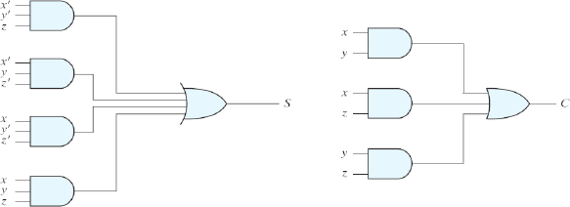
Example – Full Adder Design
Lecture 3 – 50
 Full adder implementation, using AND-OR gates
Sum = A ' B 'C + A ' BC' + AB 'C' + ABC
in in in in
C_{out} = AB + BC_{in} + AC_{in}

Slide 51

Example – Half Adder Design
Lecture 3 – 51
 Specifications – calculating 1-bit of binary addition
 Without Carry in to produce Sum and Carry out E.g.
Boolean Expression (Canonical Form, Sum of Minterms)
Sum = A ' B + AB ' = A ⊕ B C_{out} = AB
SUM
A | B | Sum | Cout
0 | 0 | 0 | 0
0 | 1 | 1 | 0
1 | 0 | 1 | 0
1 | 1 | 0 | 1
Cout

Slide 52
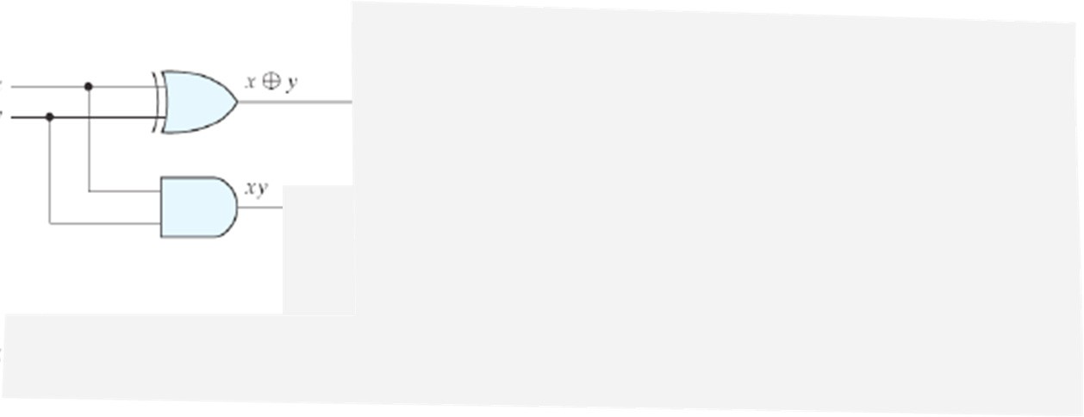
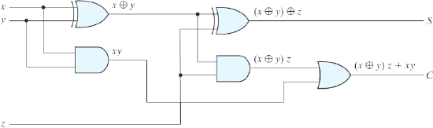
Example – Full Adder Design
Lecture 3 – 52
 Specifications – calculating 1-bit of binary addition
 Add two binary digits and Carry in to produce Sum and Carry out E.g.
A B
Cin
A | B | Cin | Sum | Cout
0 | 0 | 0 | 0 | 0
0 | 0 | 1 | 1 | 0
0 | 1 | 0 | 1 | 0
0 | 1 | 1 | 0 | 1
1 | 0 | 0 | 1 | 0
1 | 0 | 1 | 0 | 1
1 | 1 | 0 | 0 | 1
1 | 1 | 1 | 1 | 1

Slide 53
Using different gate types…
Lecture 3 – 53
 Full adder implementation, using AND-OR gates
 Full adder implemented with XOR gates

Slide 54
Lecture 3 – 54
Reading assignment
 Chapter 3.1 to 3.6 of textbook

